Slide 1


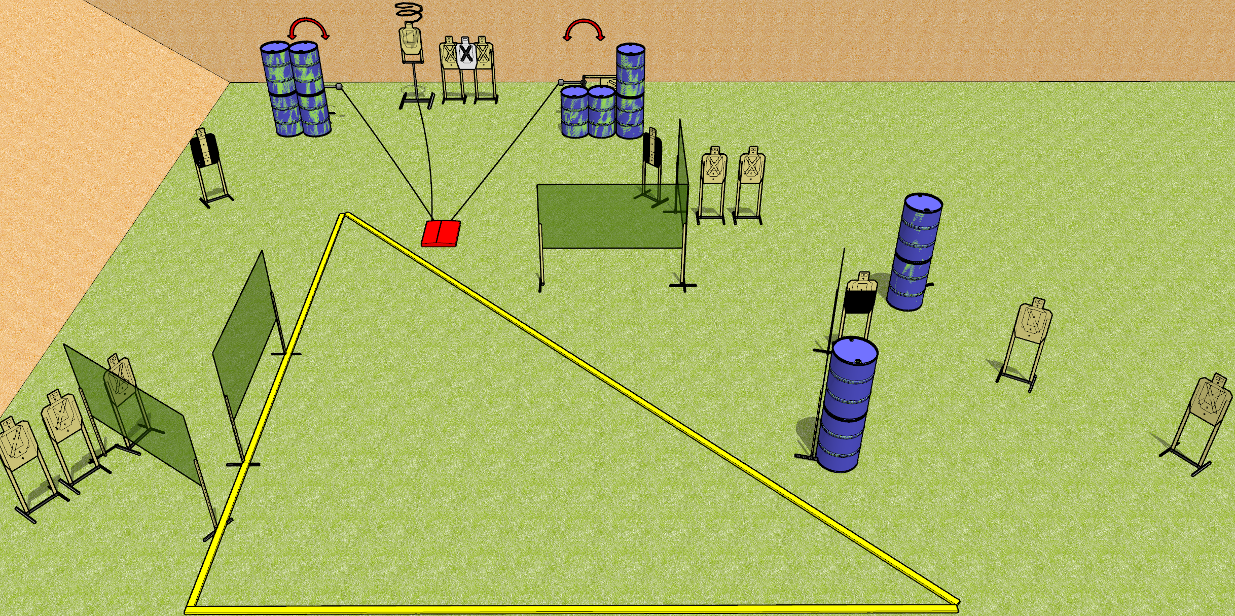
 | Dothan Gun Club – USPSA Match Geometry Course Designer : Drew Coleman
START POSITION : Standing in shooting area, wrists above shoulders
GUN READY CONDITION : Pistol loaded and holstered. PCC loaded, buttstock on belt, safety on, pointed in a safe direction. |  | SCORING: Comstock, 32 rounds TARGETS: 16 paper, 0 Steel SCORED HITS: Best 2 on paper, steel until down START-STOP: Audible, last shot RULES: Drop turner is a disappearing target
STAGE PROCEDURE: Engage targets as they become available from within the fault lines.

Slide 2
Geometry
Written Stage Briefing
Geometry is a 32 round, 160 point, Comstock field course. There are sixteen USPSA targets. The best two hits on paper will score. The start signal is audible. The stomp box will activate both swingers and the drop turner. The drop turner is a disappearing target, and will be the last target in the tablet.
Handgun start position is standing in the shooting area, wrists above shoulders. Handgun is loaded and holstered.
PCC start position is standing in the shooting area, buttstock touching belt. Carbine is loaded, held with both hands, safety on, pointed in a safe direction.
On start signal, engage the targets from within the shooting area.

